Slide 1
…$7.5B annually
In the US alone …

Slide 3


Slide 4
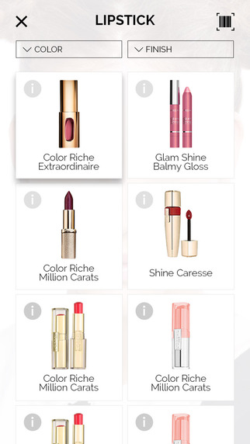

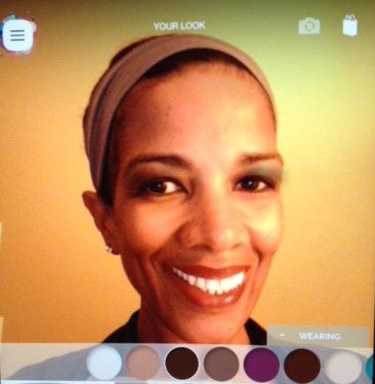

Slide 5
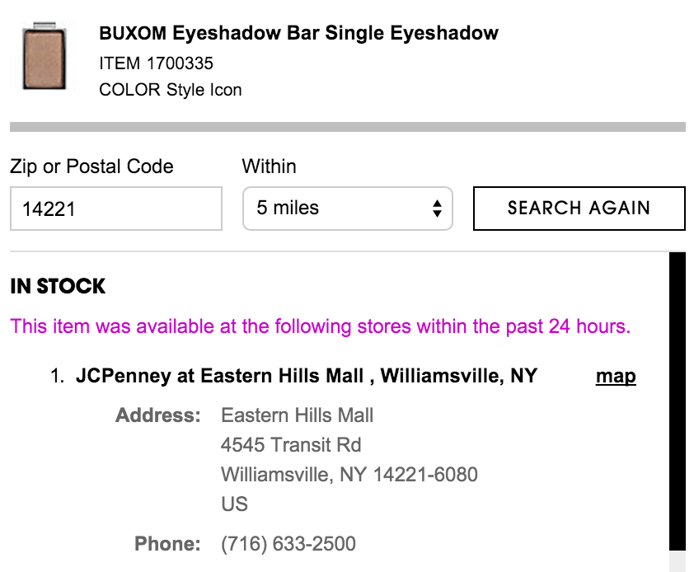
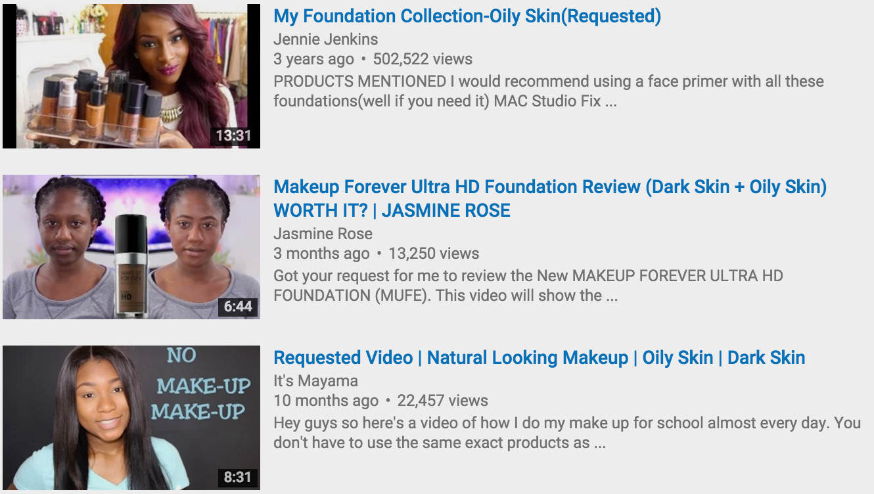
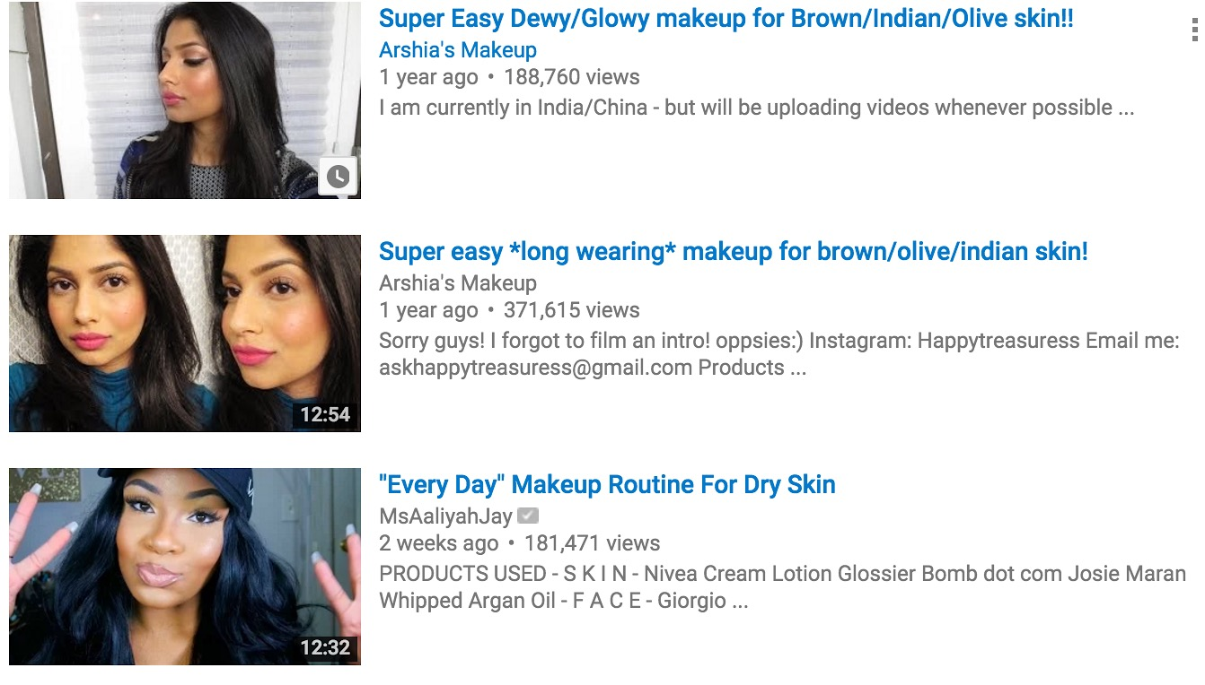

Slide 6
Global
$57B
EU
$16B
Asia/Pac
$12B

Slide 7
$8 B
$2.5 B
$7 B

Slide 8
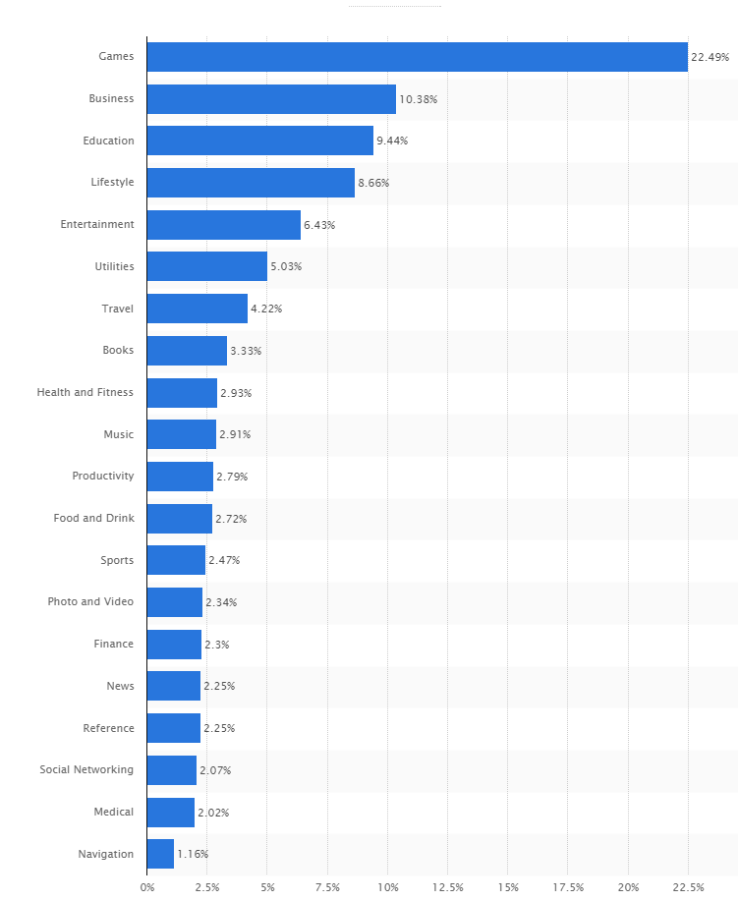
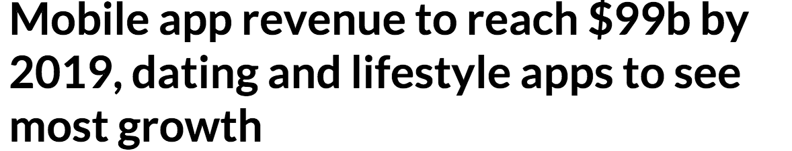

Slide 9

Real-time Application |  |  | Modiface Mirror ONLY
Product Tracking |  |  | Modiface Live ONLY
Multiple/diverse range of brands
Tutorial/How-to’s Videos

Slide 10
Tutorial/How-to’s Videos
$1.99/mo Subscription
Brand Partnership
1%~5% cut
Promotion

Slide 11
Currently Seeking:
MBA and/or strong business/marking BG
UI/UX Graphic Designer (preferably with mobile exp.)

Slide 12
Spring 2016
Ver. 1 (B)
Summer 2016
Social Media & Partnership
Fall 2016
Ver. 2 (B)
Winter 2017
Manufacturer Engagement
Summer 2017
YouTube Promo, Advertisement
Spring 2017
Ver. 3 (A)
2018
Mobile Domination?

Slide 13
CEO
Jordi Frank
Computer Science, BA, 2016
CFO
Zhi Wang
Marketing &Finance, BS, 2017
Strategy, Mobile Development, Marketing
Marketing, Finances

Slide 14
…innovation
Technology…
Globalization…
…diversity
Forefront & Leading

